Slide 1
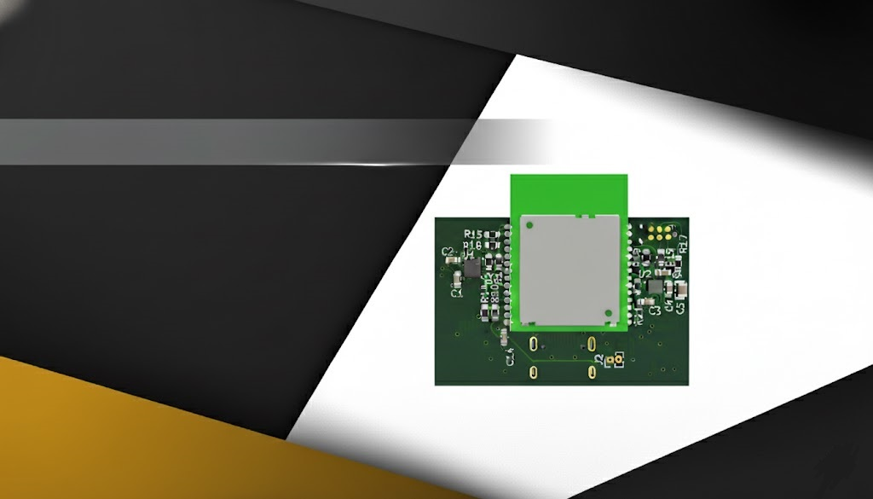

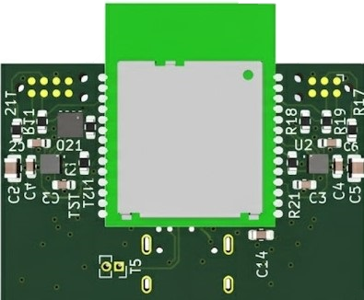
Design of a Wireless Indoor Tracking System for Multi-Sensor Data Acquisition with BLE Channel Sounding
Name: Vasiloglou Athanasios
Advisor: Prof. Evangelos V. Hristoforou, NTUA
Date: 24/10/2025
ECE
NTUA

Slide 2
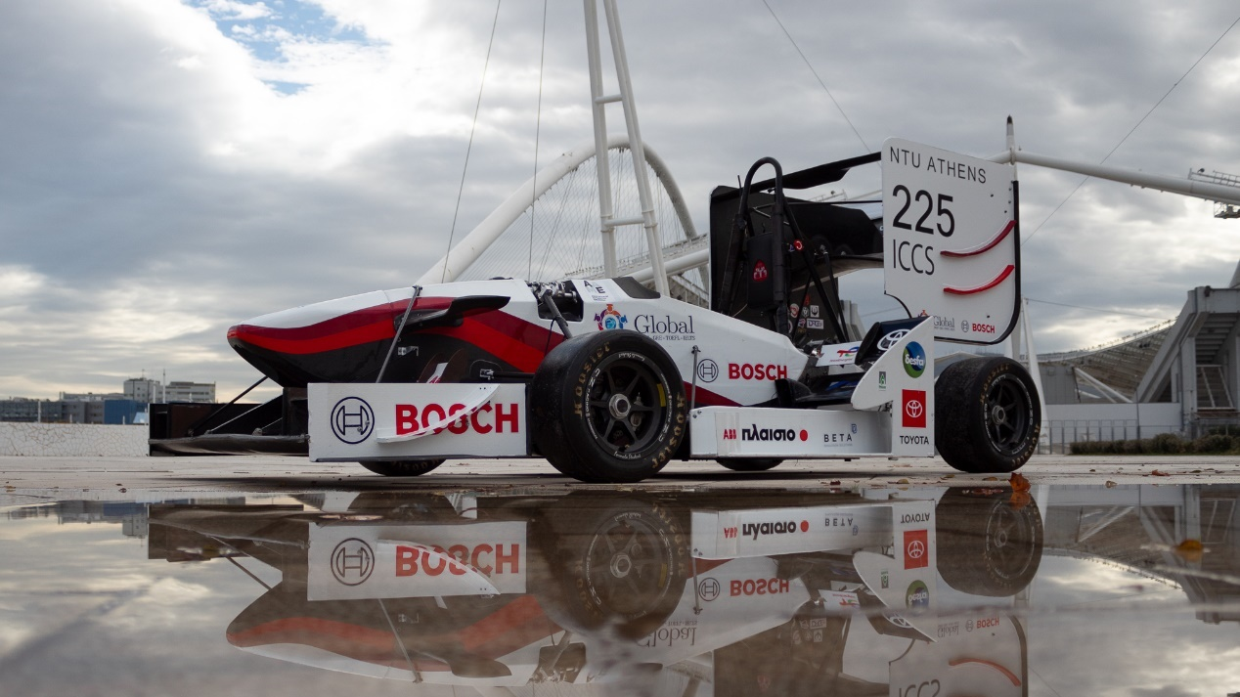

Introduction
2
Formula Student

Slide 3
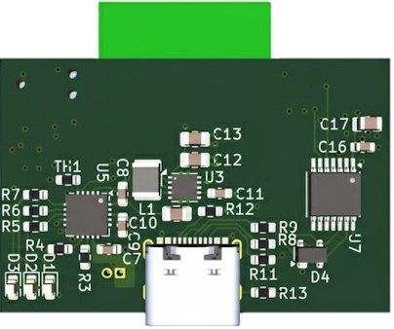
Hardware Design
Q&A

Slide 4
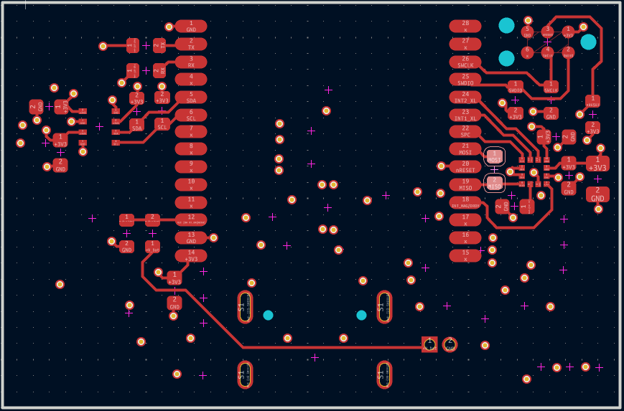
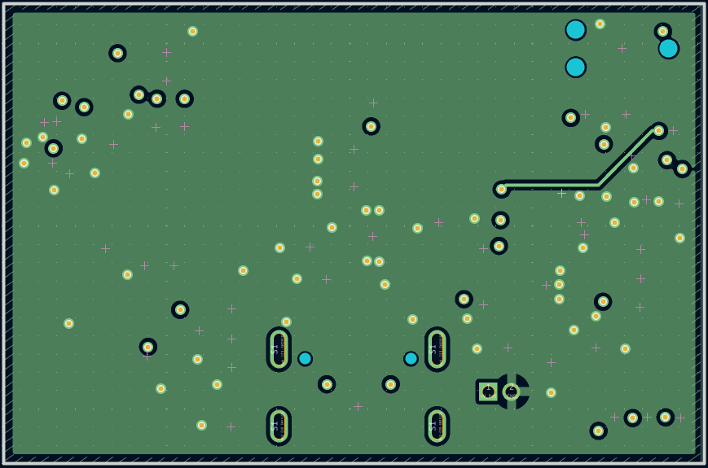
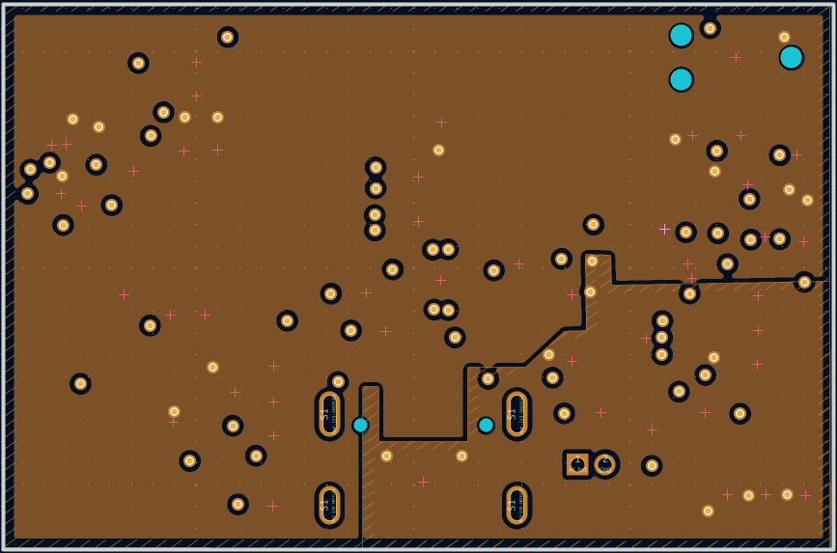
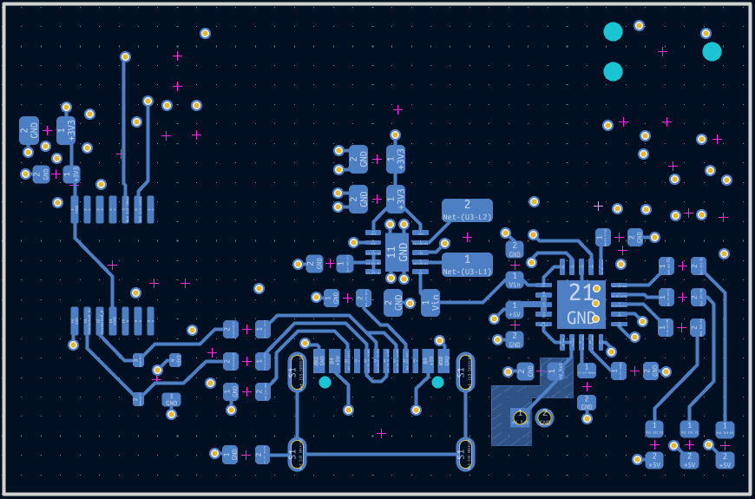
Hardware Design
4
PCB Stack Up
Top layer
Signals
ME54BS01 module
Sensors
First inner layer
Ground
Second inner layer
Power Plane
3V3
5V
Bottom layer
Power Management
USB Differential Pair
Q&A

Slide 5
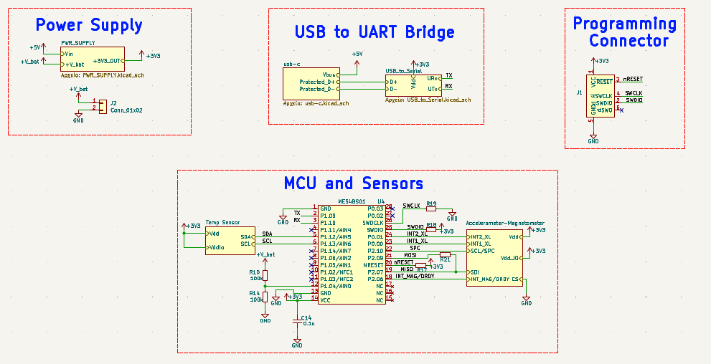
Schematic Diagram
5
Q&A

Slide 6
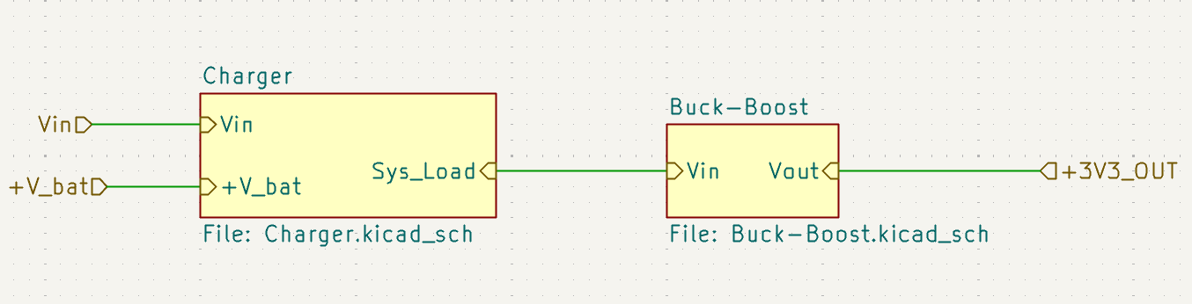
Power Supply
6
Q&A

Slide 7
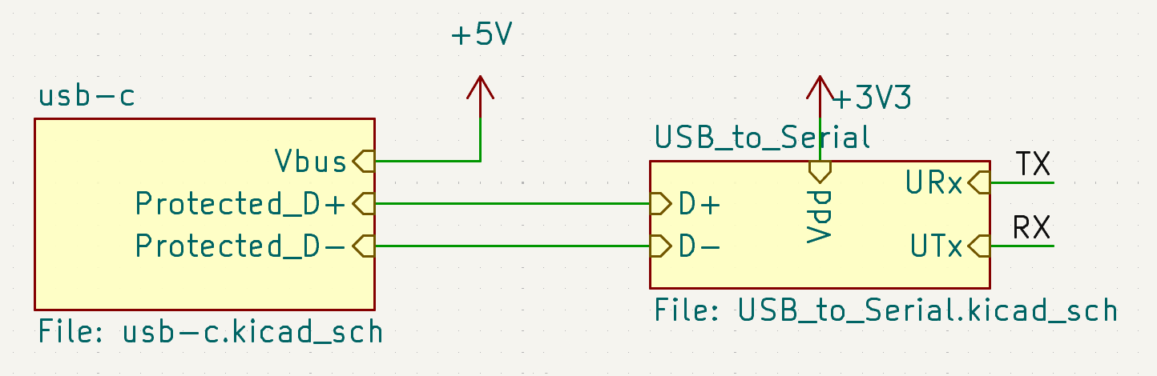
UART – USB Bridge
7
Q&A

Slide 8
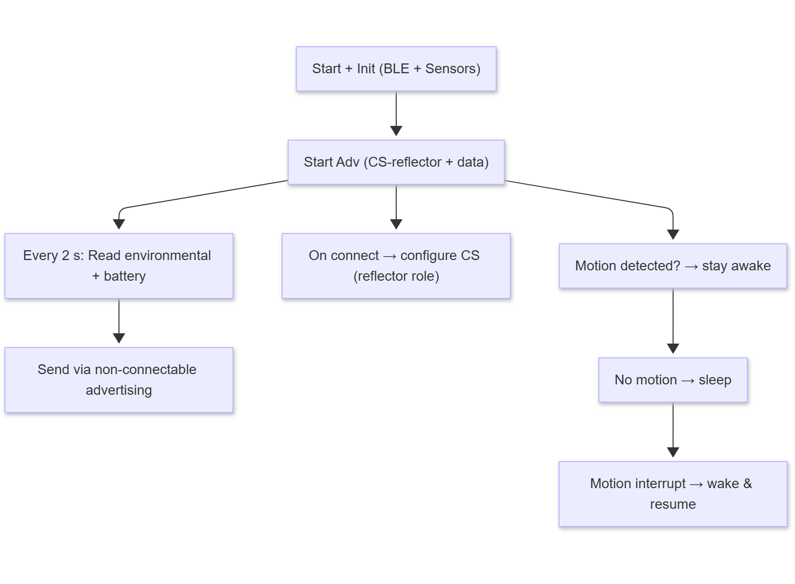
Reflector Firmware
8
Flowchart
Q&A

Slide 9
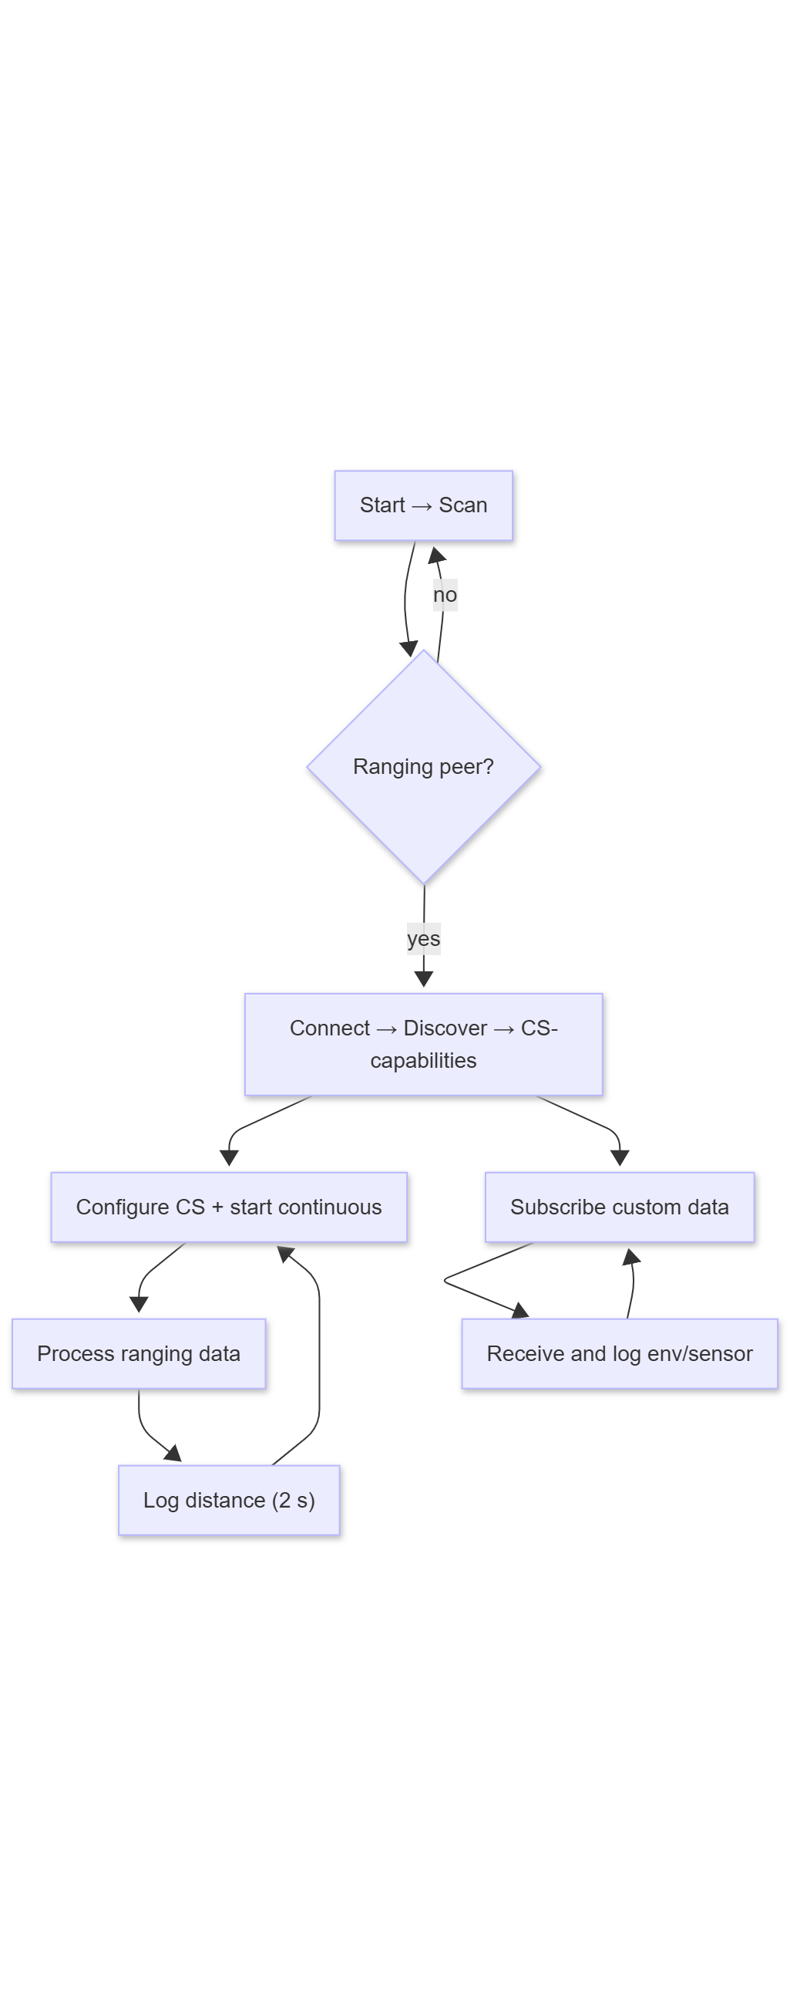
Initiator Firmware
9
Flowchart
Q&A

Slide 10
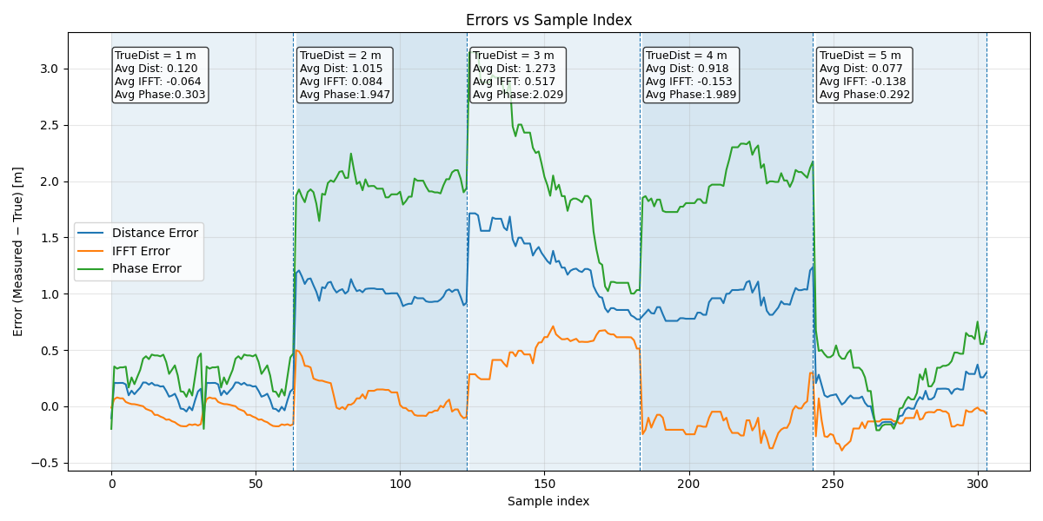
Results
10
First Testing Set up
Average IFFT error : 0.049 m
Average PBR error : 1.312 m
Average Dist error : 0.650 m
Q&A

Slide 11
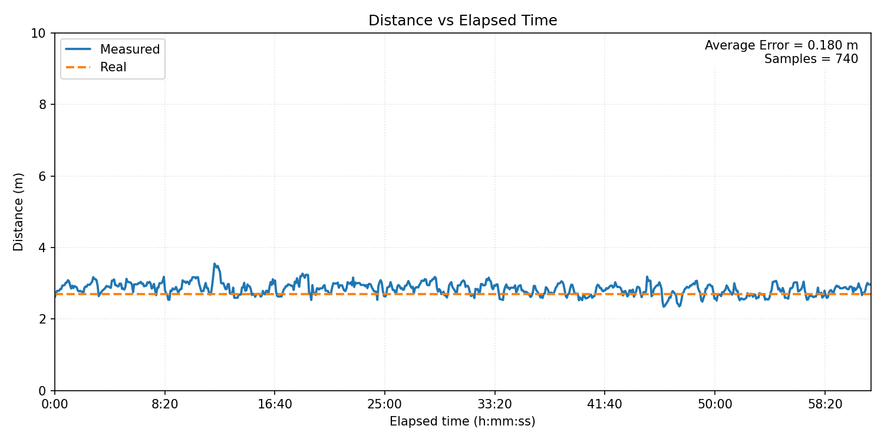
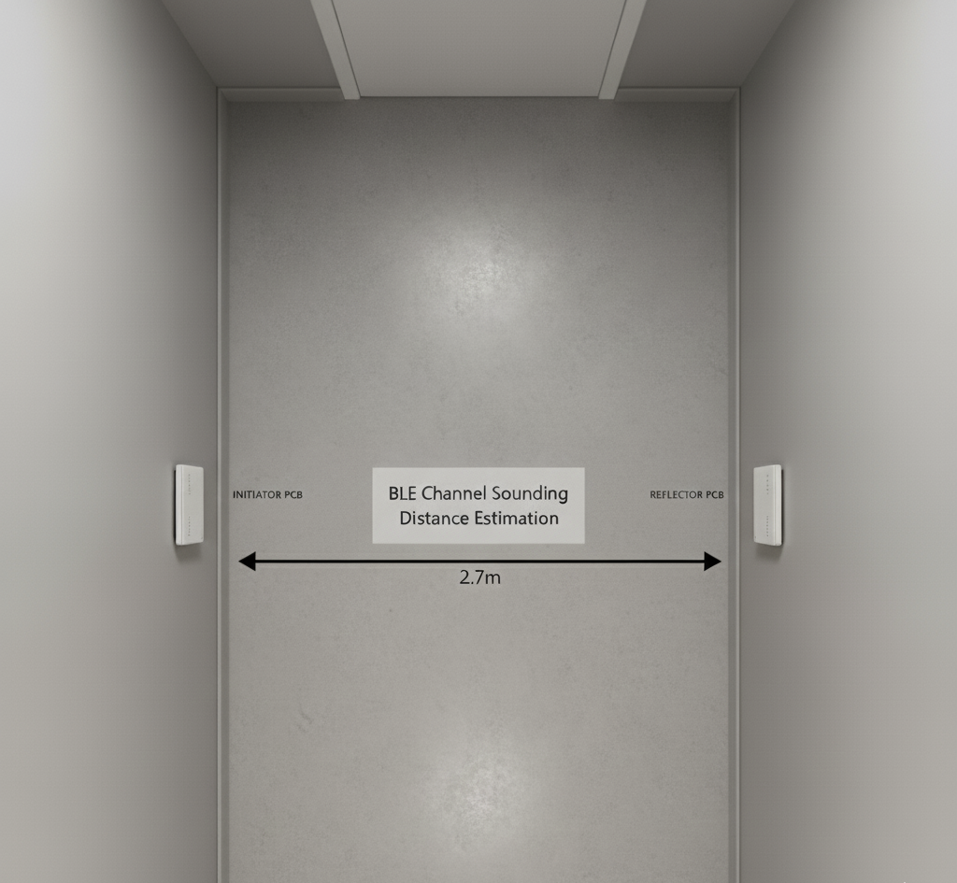
Results
11
Second Testing Set up
Q&A

Slide 12
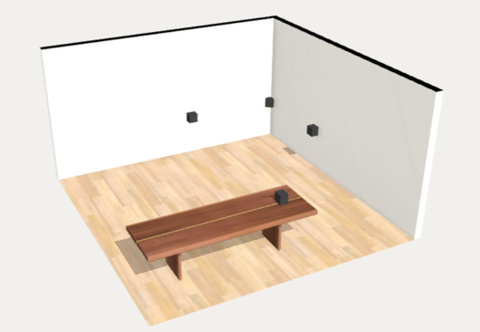
Results
12
Third Testing Set up
Initiator | Distance to Target (m)
Initiator 1 | 4.0
Initiator 2 | 4.5
Initiator 3 | 3.0
Q&A

Slide 13
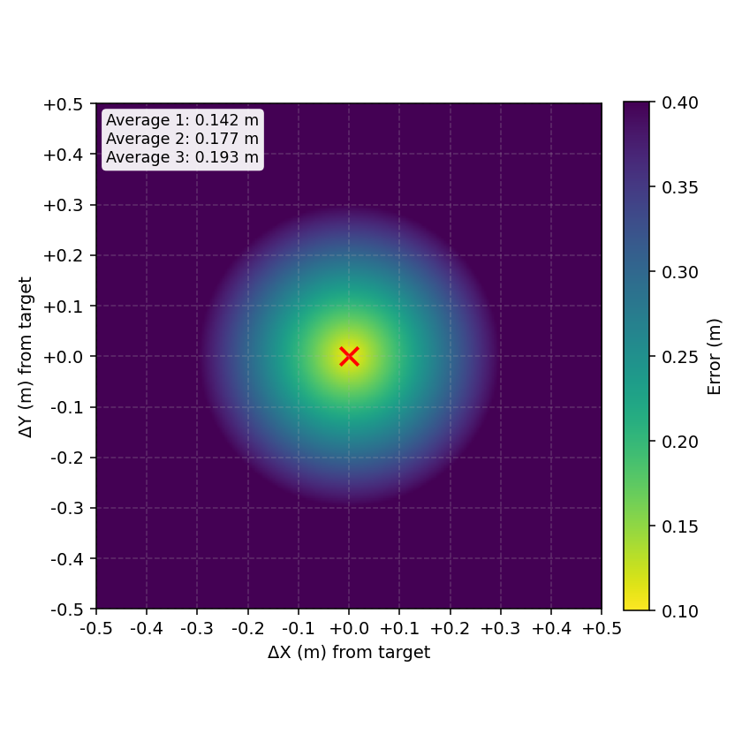
Results
13
Error Heat Map
Initiator | Average error (m)
Initiator 1 | 0.142
Initiator 2 | 0.177
Initiator 3 | 0.193

Slide 14
14
Conclusions and Perspectives
14
Results
Summary
Sub-meter ranging achieved
Modular & scalable Solution
Cost-effective design
Further Work
Complete real-time supervision Software
Anchor Hardware Optimization
Q&A
14

Slide 15
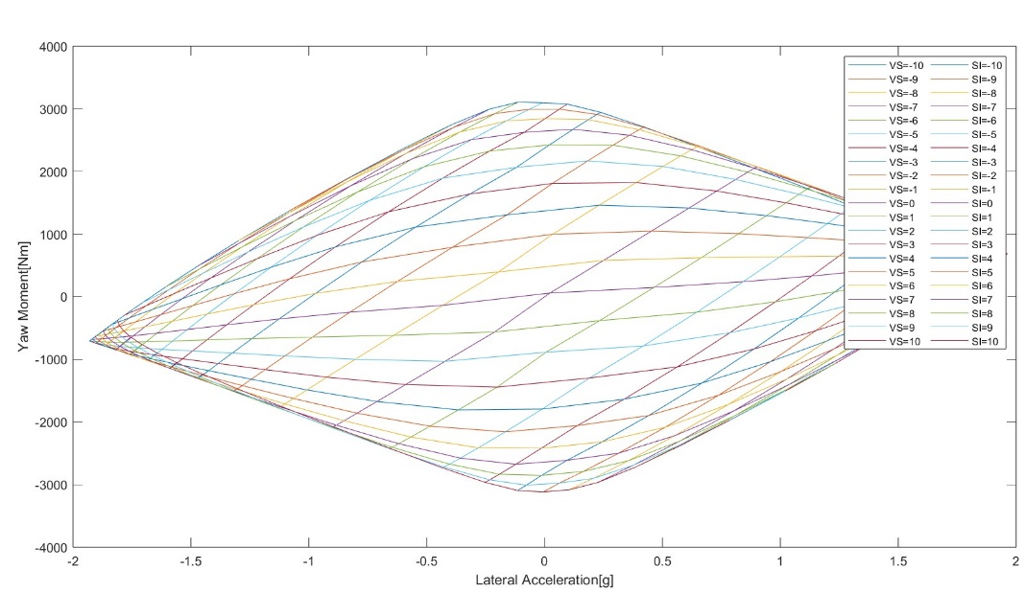
Yaw Moment Method
15
Yaw Moment Diagrams and Skid Pad Competition
5. Course Exit
4. Two counter-clockwise laps
2. Two clockwise laps
3. Transmission
1. Course Entry
Yaw Moment for different inputs
Skidpad
Q&A

Slide 16
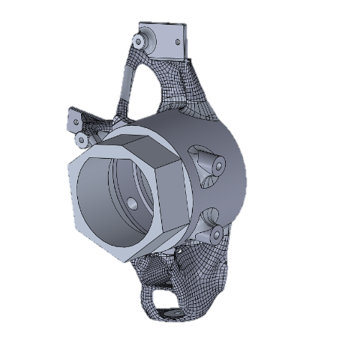
Additive Manufacturing With SLM
16
Final Geometry based on manufacturing needs
SLM Design
Smaller hole diameter
Extra matirial on imporatnt surfaces
Hexagonal jig
Q&A

Slide 17
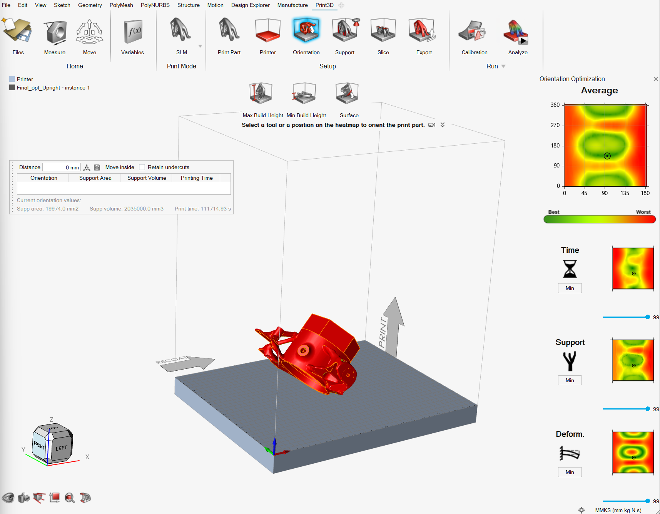
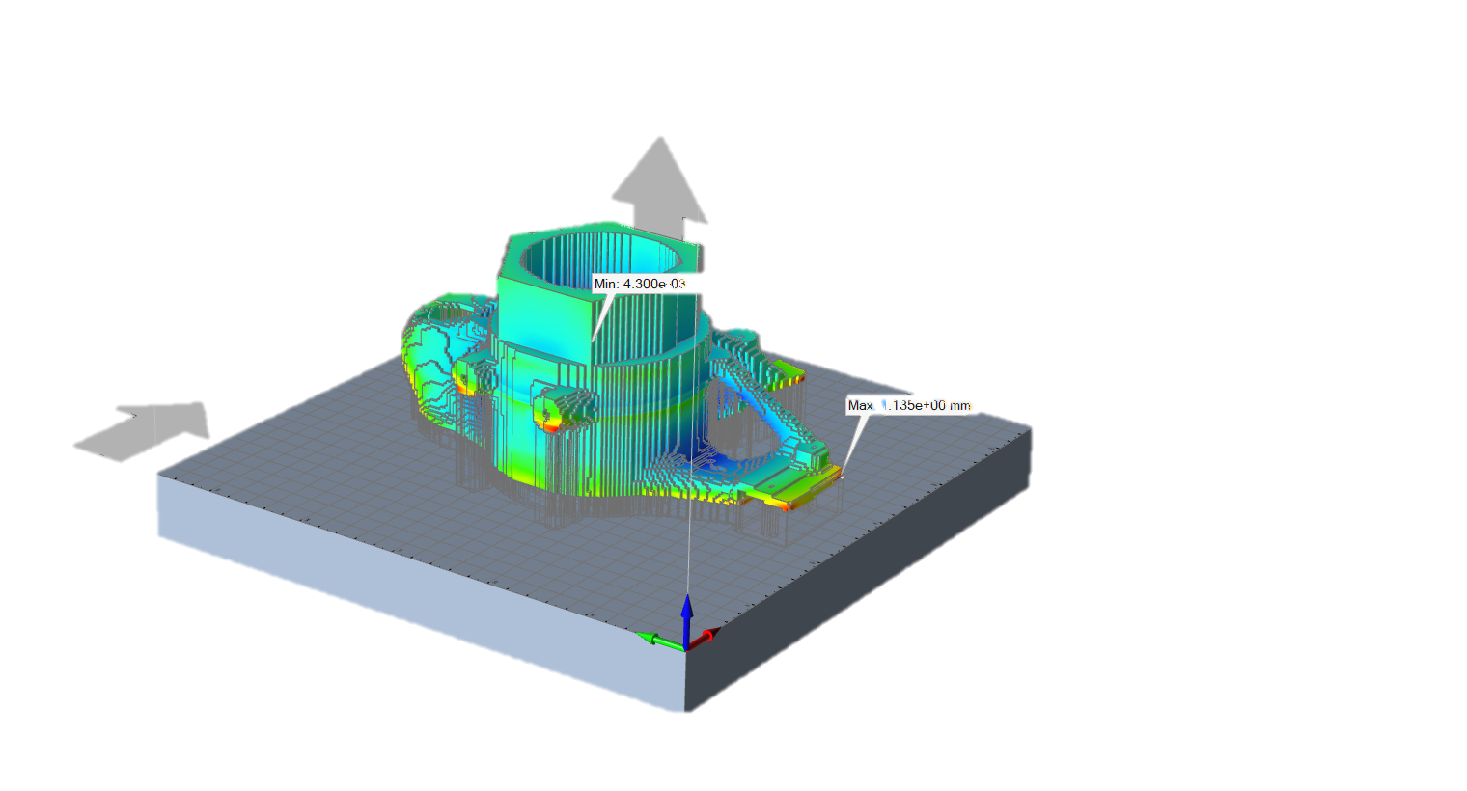
Additive Manufacturing With SLM
17
Thermo-Mechanical Analysis
SLM Simulation
Orientation
Matirial
Supports
Laser power
Powder thicknes
Q&A

Slide 18
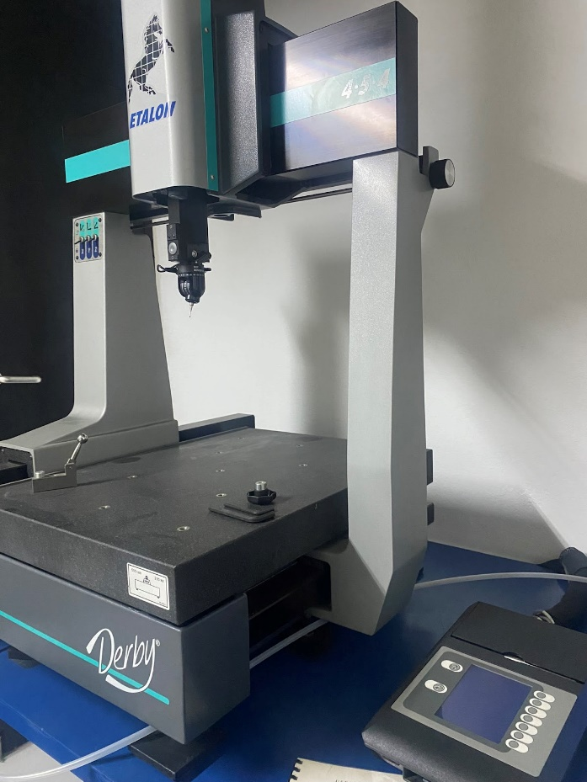
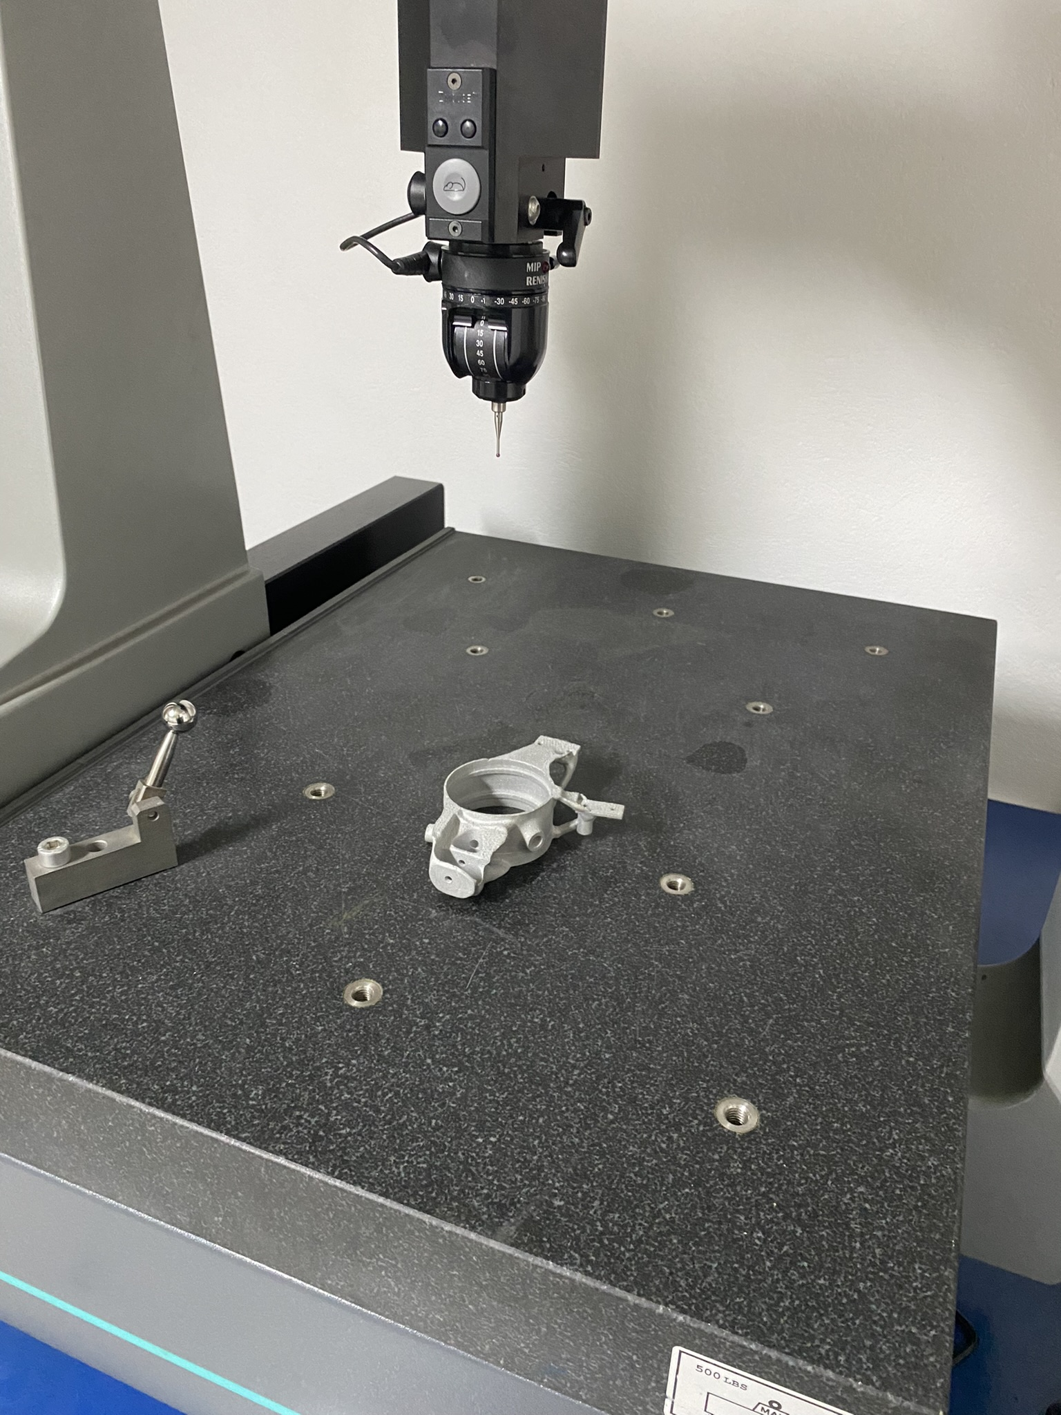
Additive Manufacturing With SLM
18
Dimensional Measurements CMM
Hole dimension accuracy of 0.342 m
Feature relative position tolerance of 0.236 mm
Flatness of 0.103 mm
Circularity of 0.160 mm
The planes were aligned within 1 degree
of the desired inclination
Q&A

Slide 19

Thanks for your Attention!
19
Q&A
Upright Conventional Design
P22 σελ.3
FEA Set Up σελ.4
YAW Moments Methods
Yaw Moment Diagrams & SkidPad Competition σελ.15
Topology Optomization
Design Space Definition σελ.5
Load cases scenario σελ.6
Hyperworks topology set up σελ.7
Analysis Set Up σελ.8
Results σελ. 9
CAD & Calculations σελ.10
Validation FEA Set Up σελ.11
Comparison Tool σελ.12
Additive Manufacturing With SLM
Final Geometry based on manufacturing needs σελ.16
Thermo-Mechanical Analysis σελ.17
Dimensional Measurements CMM σελ.18
CONCLUSIONS & PERSPECTIVES

